Slide 1

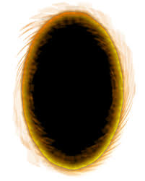
Huh?
What is this?
A portal!?

